Slide 1
Evaluation of e-Content
Prof. Indu kumar
CIET-NCERT

Slide 2
The need of e-Content evaluation
We have to focus on these three
What do we understand by eContents which need to be evaluated
Why these eContent need to be evaluated
How they should to be evaluated (The Process/Methods )

Slide 3
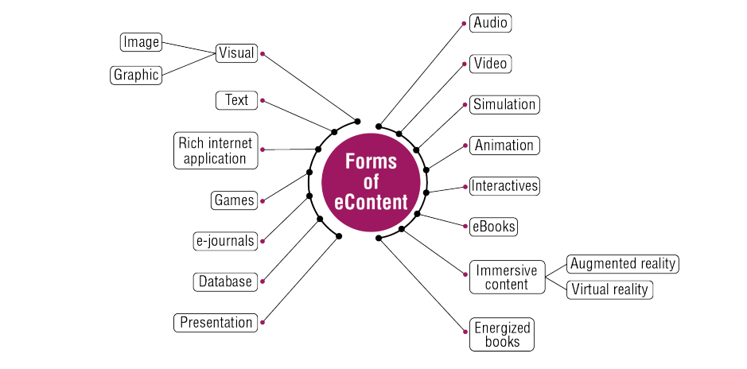
eContents to be Evaluated

Slide 4
Why e-Content need to be Evaluated
For the assessment of-
1.Reliability and Validity 3. Cost Effectiveness
2. Appropriateness as per 4. Licensing
i) The nature of content ii) Context of the learner
iii) Methods of Teaching iv) Available technology

Slide 5
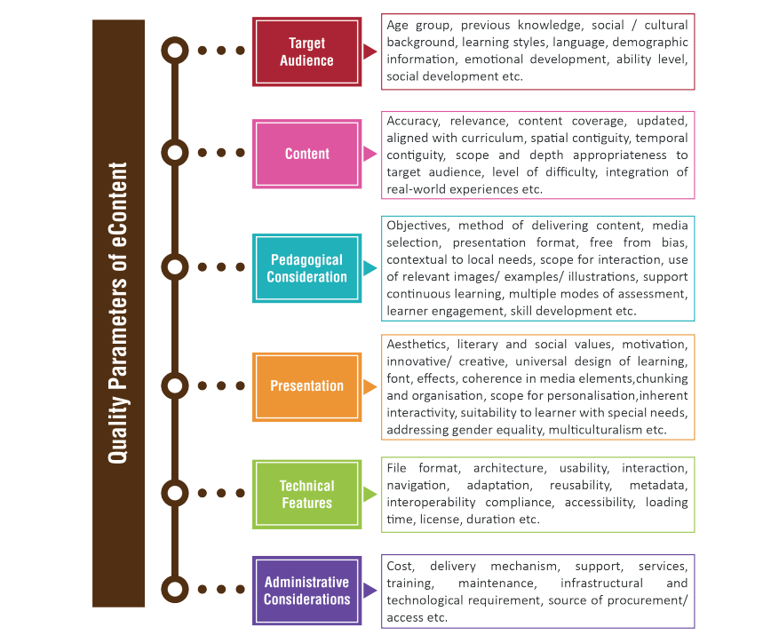
The Process/Methods

Slide 6
How it should to be Evaluated (The Process/Methods)
We need to have eContent evaluation tool based on the parameters

Slide 7
Parameters for e-content Evaluation
https://docs.google.com/document/d/17hiqnZ9J2L9i965nj6WluitKtAt9ILxP/edit
https://docs.google.com/document/d/1EgV7eeQA2I4N7muvNLzwT4W-B8LXo1Ml/edit

Slide 8
Guidelines e-Content Development
CIET | Central Institute of Educational Technology

Slide 9
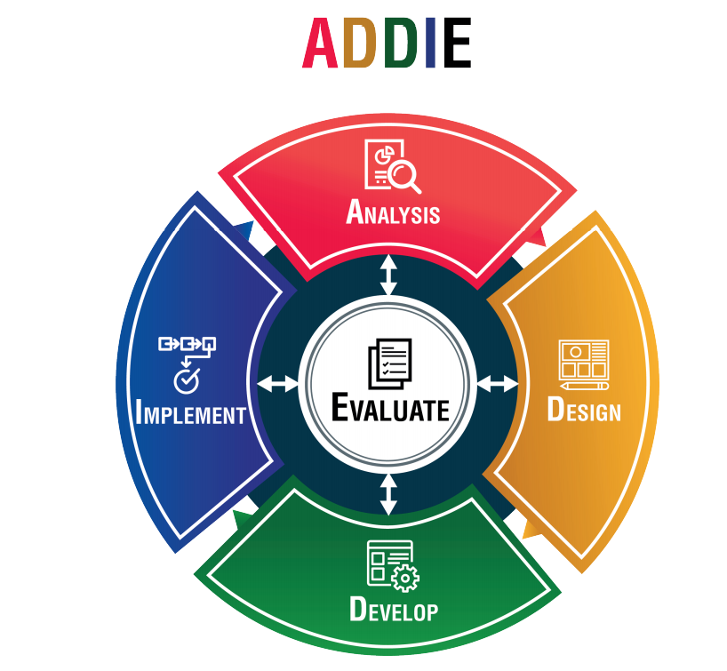
Evaluation is an intrinsic component of creation process

Slide 10
Questions & Discussion
Fight COVID-19
Practice Social Distancing, Use Mask, Practice Hand Hygiene and Stay Safe
Learn from Home Online
Thanks for your attention

